Slide 1
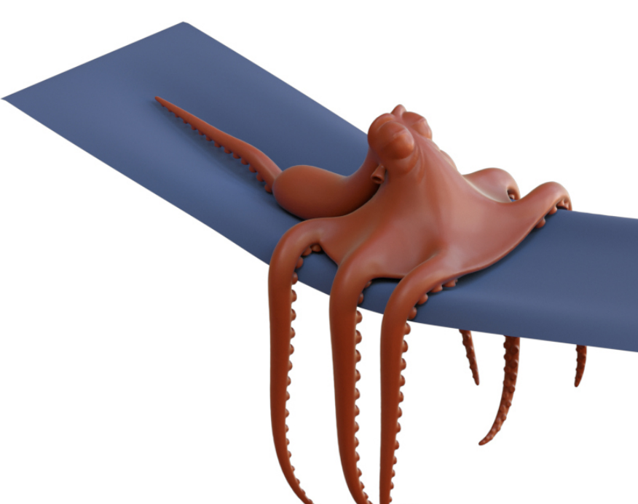
Deformable Simulation
Spatial and Temporal Discretization

Slide 2
Outline today
Integration in time
Explicit
Implicit
Integration in space
Mass-Spring system
The finite element method

Slide 3
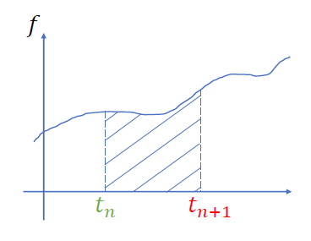



Equations of motion (general cases)
$$M\ddot{x}=f(x)$$
$$\dot{x}=v \dot{v}=a=M^{−1}f$$
$$x\left(t_{n}+h\right)=x\left(t_{n}\right)+\int_{0}^{h}{v\left(t_{n}+t\right)dt}$$
$$v\left(t_{n}+h\right)=v\left(t_{n}\right)+\int_{0}^{h}{M^{−1}f\left(t_{n}+t\right)dt}$$
$h=t_{n+1}−t_{n}$ is the time-step size
We don’t know how to integrate this quantity
We don’t know anything after $t_{n}$

Slide 4

Time integration (Explicit)
$$x_{n+1}=x\left(t_{n}\right)+\int_{0}^{h}{v\left(t_{n}+t\right)dt}≈x_{n}+hv_{n}$$
$$v_{n+1}=v\left(t_{n}\right)+\int_{0}^{h}{M^{−1}f\left(t_{n}+t\right)dt}=v_{n}+hM^{−1}f(x_{n})$$
Accuracy: 1st-order accurate
$$\int_{0}^{h}{v\left(t_{n}+t\right)dt}=hv\left(t_{n}+0\right)+\frac{h^{2}}{2}v^{′}\left(t_{n}+0\right)+…$$
$=hv_{n}+O(h^{2})$

Slide 5
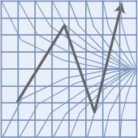
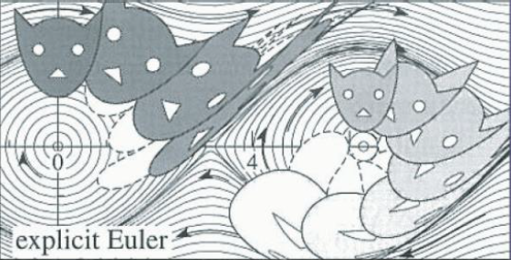

Time integration (Explicit)
Stability:
$\frac{d}{dt}x=λx$
$x_{n+1}=x_{n}+hλx_{n}$
$x_{n}={\left(1+hλ\right)}^{n}x_{0}$
Condition of stability:
$\left|1+hλ\right|≤1, h≤\frac{2}{\left|λ\right|}$
Explicit Euler is extremely fast, but it will also increase the system energy gradually. Not recommended in almost all situations.

Slide 6
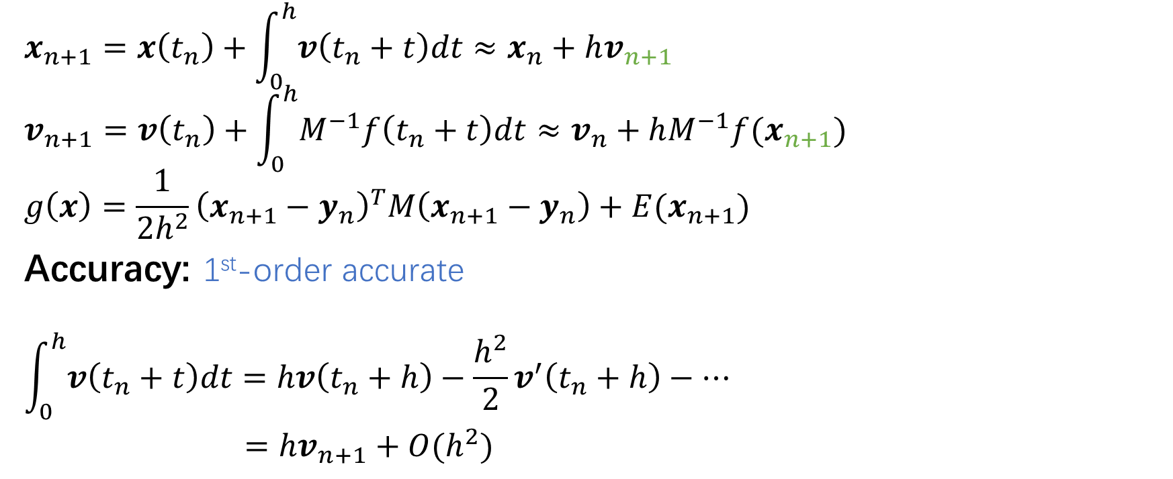

Time integration (Implicit)
$$x_{n+1}=x\left(t_{n}\right)+\int_{0}^{h}{v\left(t_{n}+t\right)dt}≈x_{n}+hv_{n+1}$$
$$v_{n+1}=v\left(t_{n}\right)+\int_{0}^{h}{M^{−1}f\left(t_{n}+t\right)dt}≈v_{n}+hM^{−1}f(x_{n+1})$$
$$g\left(x\right)=\frac{1}{2h^{2}}{\left(x_{n+1}−y_{n}\right)}^{T}M\left(x_{n+1}−y_{n}\right)+E(x_{n+1})$$
Accuracy: 1st-order accurate
$$\int_{0}^{h}{v\left(t_{n}+t\right)dt}=hv\left(t_{n}+h\right)−\frac{h^{2}}{2}v^{′}\left(t_{n}+h\right)−…$$
$=hv_{n+1}+O(h^{2})$
Expand where $Δt=h$

Slide 7
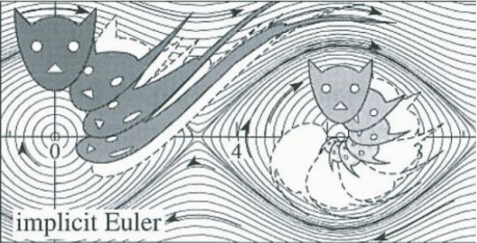

Time integration (Implicit)
Stability:
$\frac{d}{dt}x=λx$
$x_{n+1}=x_{n}+hλx_{n+1}$
$x_{n}={\left(1−hλ\right)}^{−n}x_{0}$
Condition of stability:
$\left|1−hλ\right|≥1$
Implicit Euler integrals are unconditionally stable!
Implicit Euler is often expensive due to the nonlinear optimization, it is often stable for large time steps and is widely used in performance centric applications. (game / MR / design / animation)

Slide 8
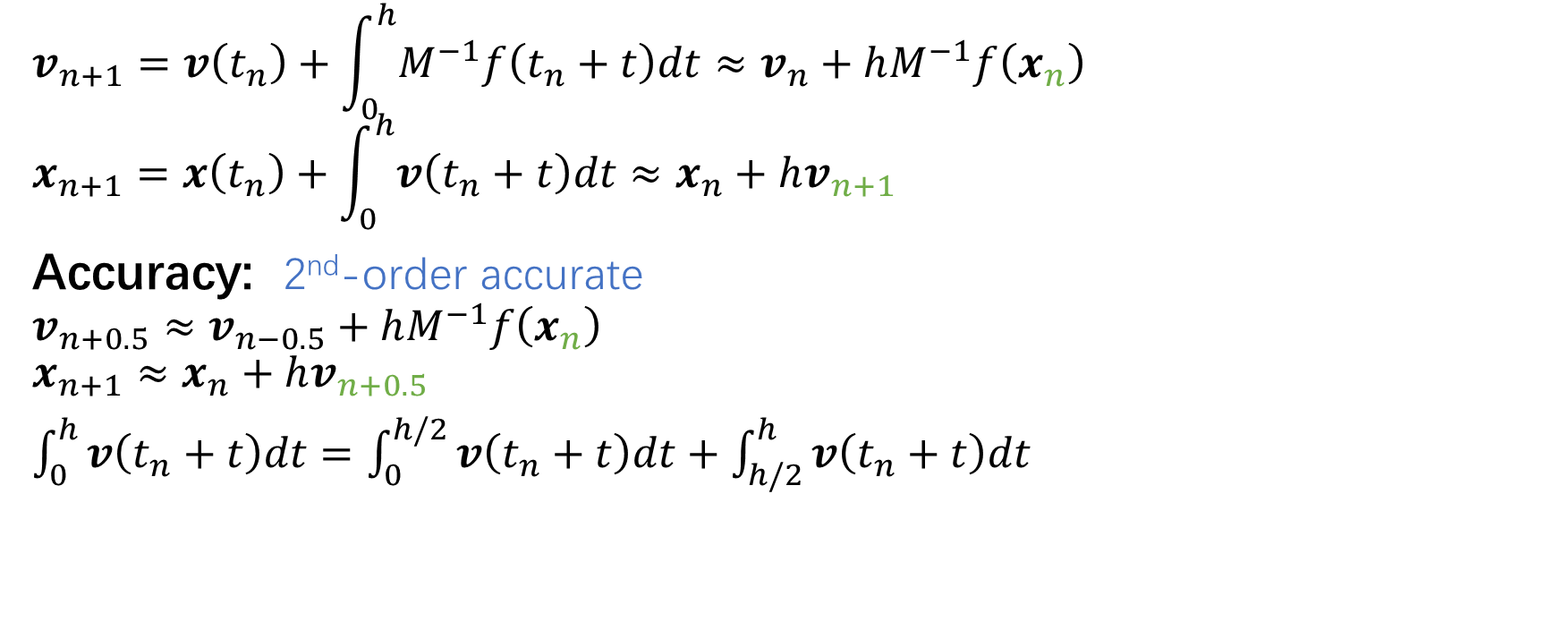
Time integration (Symplectic)
$$v_{n+1}=v\left(t_{n}\right)+\int_{0}^{h}{M^{−1}f\left(t_{n}+t\right)dt}≈v_{n}+hM^{−1}f\left(x_{n}\right)$$
$$x_{n+1}=x\left(t_{n}\right)+\int_{0}^{h}{v\left(t_{n}+t\right)dt}≈x_{n}+hv_{n+1}$$
Accuracy: 2nd-order accurate
$$v_{n+0.5}≈v_{n−0.5}+hM^{−1}f\left(x_{n}\right)$$
$$x_{n+1}≈x_{n}+hv_{n+0.5}$$
$\int_{0}^{h}{v\left(t_{n}+t\right)dt}=\int_{0}^{h/2}{v\left(t_{n}+t\right)dt}+\int_{h/2}^{h}{v\left(t_{n}+t\right)dt}$
Midpoint

